Slide 1
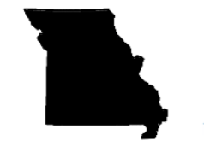
Clear My Record Expungement Project
Ellen Suni, Staci Pratt, Sam Capkovic, Iris Siadatifard, Savina Balano

Slide 2
Who are we?
UMKC School of Law professors and students in collaboration with Code For KC volunteers, Prosecutors from Jackson & St. Louis Counties, and Empower Missouri
Notes:
Sam
-Partnering with Empower Missouri

Slide 3
The Punishment that Never Ends
A criminal record can affect employment, housing, and public benefits
⅓ of Americans arrested by age 23
50% less likely to receive a job offer
Notes:
Savina
-This is an example of financial inequity. People who need relief the most are unable to get it.

Slide 4
Race, Poverty, and Punishment
In Missouri:
Overcriminalization more negatively affects people of color
African Americans are 91% more likely to be arrested than whites, 68% more likely to be searched, and over 65% more likely to be arrested
Similar search and arrest statistics for Hispanics
Poor people are likely to be represented by Public Defenders who are notoriously overworked
Notes:
Iris
Cant adequately defend the clients appointed to them

Slide 5
What is Expungement?
Court removes one or more convictions from criminal history
Fresh start for jobs, housing, and education
Answer “NO” on most applications
Notes:
Iris
Why does this matter?: With the coronavirus pandemic occurring right now, this could potentially disproportionately affect those who have criminal records. Seeing as having a criminal record can affect access to decent jobs and housing, this might lead to negative effects. People who are unable to maintain stable housing and a steady income are less likely to have adequate access to the internet. This is seen as an outside expense.
. -During this time, communication has switched to being largely virtual. Not having the capabilities to effectively communicate could be a major disadvantage for these communities further hindering their access to employment and housing

Slide 6
2018: Expanded Expungement
Missouri Legislature amends the statute to make many more offenses expungeable, including most drug offenses
Shorter period to wait: 3 years from completion of sentence for misdemeanor, 7 years for felony, with no intervening criminality
2019 amendment added stealing as an expungeable offense
Mo. Rev. Stat. § 610.140
Notes:
Iris
Missouri does limit the number of convictions
This is dependent on the conviction itself.
-A single conviction can include multiple counts
FOR EXAMPLE: One conviction including – including one count of paraphernalia and one count of possession of marajuana – if occured at the same time

Slide 7
But Significant Limitations
Eleven categories of crimes excluded
Lifetime limits on number of convictions that can be expunged:
1 felony conviction
2 misdemeanors or ordinances with jail time
No limit on infractions
Can only answer “No” if question relates to convictions, not arrests or charges
Mo. Rev. Stat. § 610.140
Notes:
Iris
Missouri does limit the number of convictions
This is dependent on the conviction itself.
-A single conviction can include multiple counts
FOR EXAMPLE: One conviction including – including one count of paraphernalia and one count of possession of marajuana – if occured at the same time

Slide 8
Law, Tech, & Public Policy: The Beginning
Initial goals: Develop tech for online expungement to help people who can’t afford lawyers
But statute too complicated
So create tech to support an expungement clinic to serve people of low and moderate means until online expungement possible
Notes:
Sam
-costs 2-3,000 to do expungement on average

Slide 9
LT&PP
Spring 2019
Informational Sessions
Website Development
UX Testing
Case Management System
Expungement Day
Candidate Backlog
Notes:
Sam
-went into this semester recognizing that not many individuals know what they are convicted of and often do not have access to their own court documents.

Slide 10
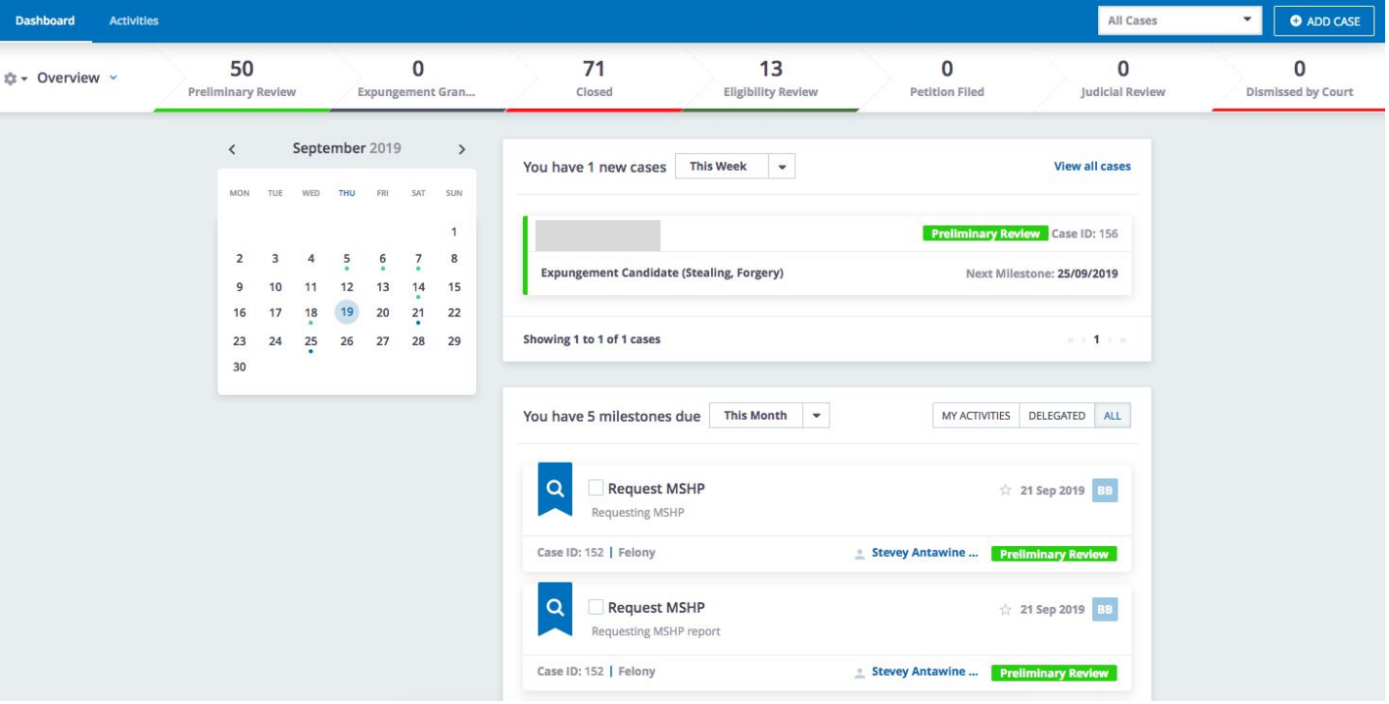
Case Management System
Notes:
Sam
-contact relationship manager
-volunteer manager
-event registration/communication
-case/file management
-development of excel sheet with objective of auto-populating application

Slide 11
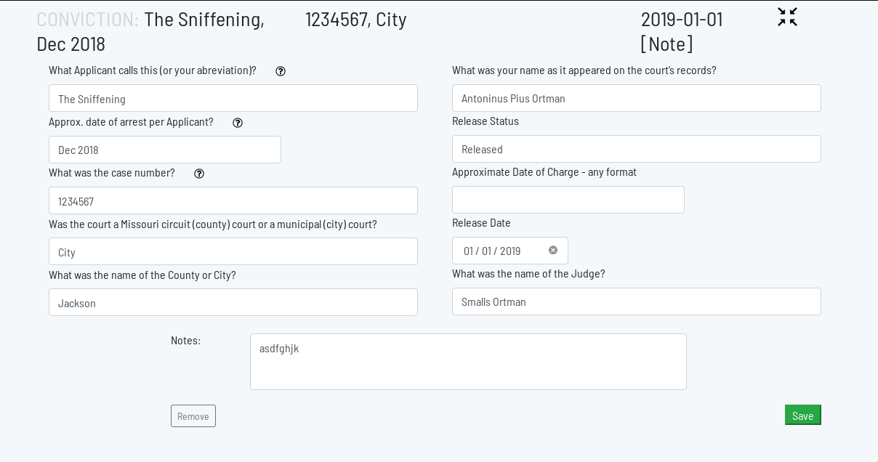
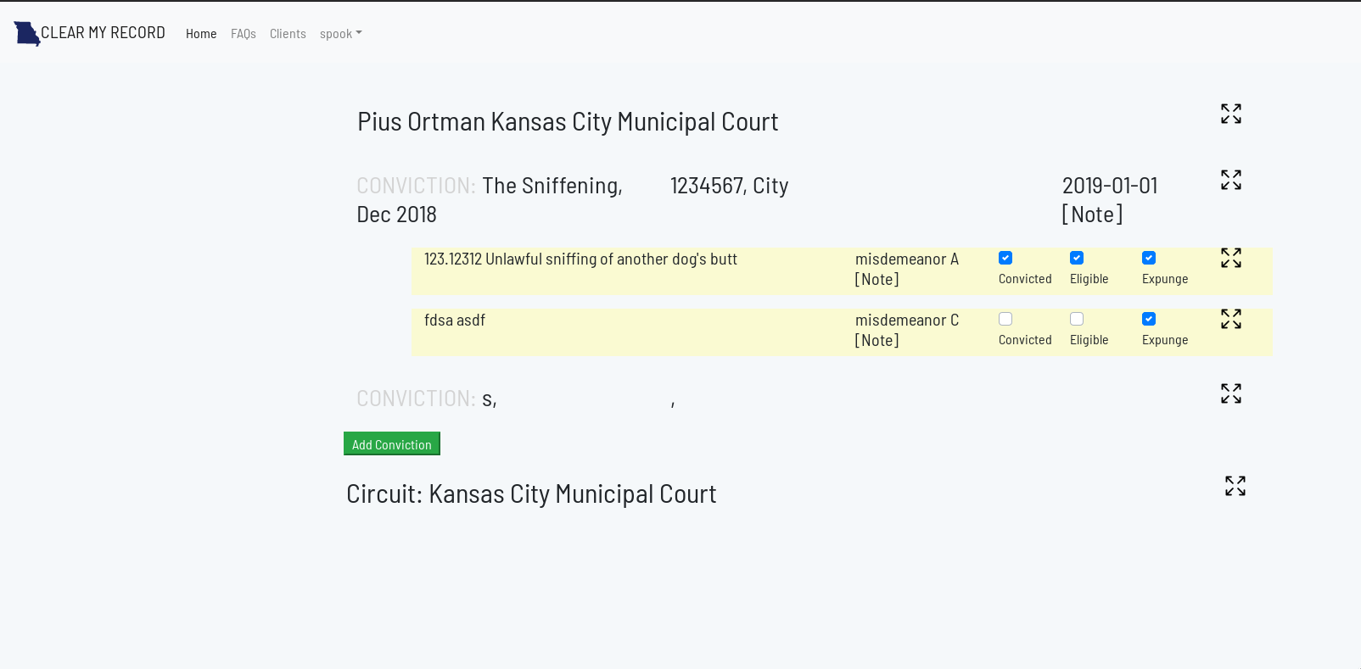
Clinic App
Notes:
Sam
-Can aggregate data
-Summarize Information
-Generate Petition
-now utilizing an excel sheet

Slide 12
LT&PP
Fall 2019
Process Preliminary Background Checks
300/900 accomplished
123 Preliminary Reviews,
202 Closed, 41 Eligibility Review
Update Case Management System
Notes:
Savina
When we started the semester, previously 300 had been completed. Now we have processed well over 400 checks, which puts us over the half way mark for completing the checks.

Slide 13
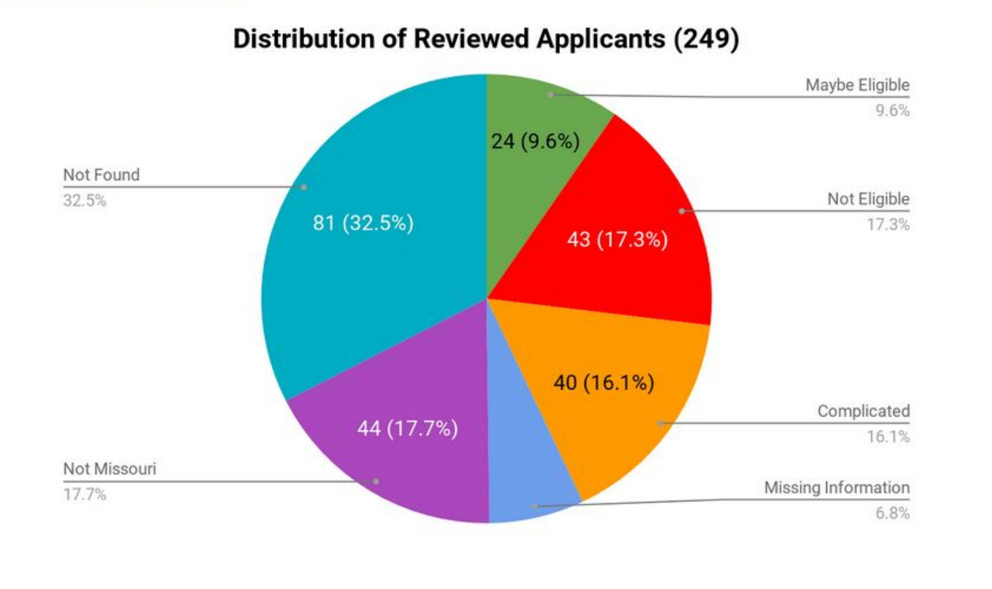
Notes:
Students can discuss process of background checks - Sam
Few applicants are able to obtain expungement under the current statute. Only 10% of people who sought help looked likely to qualify.

Slide 14
Problems with the Current Statute
Significant Ambiguity
Time consuming and difficult to find data
Takes law student 45 minutes on average
Must consult MSHP, Lexis, CaseNet
Most sources are hard to access or cost money
Penalty for inaccuracy - leads to a 1 year wait to refile
Complicated process
Number limits: 1 felony, 2 misdemeanors
Notes:
Sam & Comments
-Need to establish clear rules to determine eligibility
-clarify timing provisions in the statute. Differences between courts
-access to one comprehensive data source
-User friendly online and paper applications
-no penalty for inaccuracy
-because of the 1 felony and 2 misdemeanors have to choose wisely - need attorneys help

Slide 15
Why is Data So Important? The Clean Period
Expungeable Felony:
7 Year Clean Period Required
No arrests, pending charges, convictions, or offenses allowed*
1990: Drug Trafficking, Class B Felony
2013
2020: Expungement Petition Filed
Notes:
Staci--most people do not know--the exact nature of the offense, the date of disposition, the specific court involved, and what else might be on their record.
we need to know almost everything during the Clean Period to ensure the petition for expungement is viable--some few exceptions for traffic offenses, but not for failure to register your vehicle (poverty offense)

Slide 16
LT&PP
Legislative Workshop
Purpose: address problems with the current statute
Jolie Justus helped with drafting
Senator Kiki Curls agreed to sponsor the bill: SB 519
Left Senate Jan. 2020
Went to Jeff City to find a new sponsor March 2020
ASUM students and Empower Missouri provided help
Notes:
Staci
-process for redrafting the bill - 9/21/19--gathered together with coders, Senators, Representatives, and practising attorneys to address problems in the application of the statute. Number of identified problems: include limitation on number of felony and misdemeanors that can be expunged. Complexity of determination. Difficult to access data in bulk. Must do individual searches. Inconsistencies in the types of offenses that are expungeable--forgery is not, but similar offenses are.
Drafting efforts begin November of 2019
-on the project we thought that we could do it individually but ran into some problems. Realized that getting ahold of data was very difficult. With three different databases (casenet, mo highway patrol and lexis) it takes about an hour for law students to process. This exponentially increases time.
-Shook, Hardy & Bacon along with Stinson LLP - their interest is because of non-profits they are working with - such as Operation Breakthrough
-Jolie Justus works at Shook, Hardy & Bacon - was apart of the MO State Senate and the MO State House

Slide 17
Legislative Support
Sponsors
Sen. Brian Williams (D) SB 1068
Rep. Ron Hicks (R) HB 2680
ASUM students
Law Firms
Shook, Hardy & Bacon
Stinson LLP
Notes:
Staci
Originally, the senate bill was SB 519 before Williams filed.
-bill has bipartisan support: supported by conservatives because of the workforce development. This will gets people back in the job market.
-liberal support because it addresses the results of overcriminalization and racial disparity
ASUM: Associated Students of University of Missouri; intern at the legislature

Slide 18
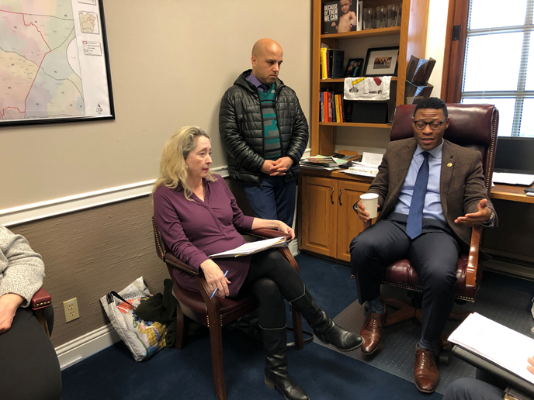
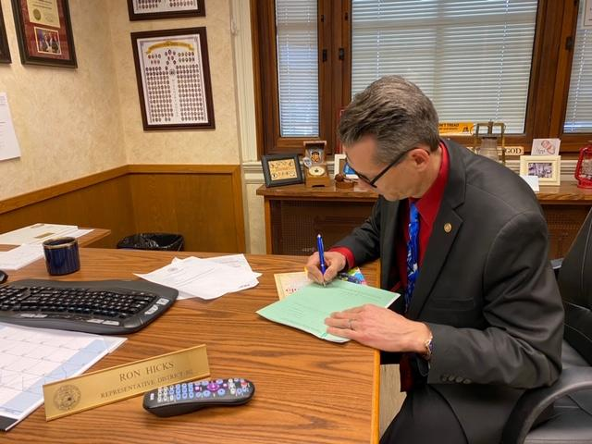
Senator Williams
Notes:
Staci
Sen. Williams pictured with CMR team members Staci Pratt and Ayyoub Ajmi expressing support for our bill as well as his, SB 952 would reduce the waiting time for expungements and reduce the $250 surcharge.

Slide 19
Representative Hicks
Notes:
Staci
Thanks to the wonderful work of students from ASUM, we have a House Sponsor. Representative Hicks is pictured here signing the greenback of HB 2630, the House version of the expungement bill. Rep. Hicks has also sponsored HB 2060, which allows certain marijuana-related offenses and violations to be expunged if the offenses or violations occurred in Missouri prior to the issuance of a patient identification card

Slide 20
Access to Data: In Bulk
≈ 40% applicants lacked comprehensive data
No Single Source of Data
Bill Provides data access to Expungement Clinics
Central Repository (Missouri State Highway Patrol)
Use of API
Notes:
Staci--want access so clinics can easily make decision expungable or not
2nd Clean Slate--remove lot of people from waiting line. Otherwise, same process--individual.

Slide 21
Primary Substantive Changes
Streamlines statutory language
Defines “Same course of criminal conduct”
Arose under the same or substantially similar criminal statute; or
Offenses occur within a time period suggesting a common connection between the offenses, not exceeding one year.
Adds forgery and misdemeanor gun offenses as expungeable
Keeps traffic “crimes of poverty” from preventing expungement
Notes:
Dean Suni → define same course of criminal conduct. - Important because it expands lifetime eligible number of offenses. Under this amendment, offenses, violations, or infractions are committed as part of the "same course of criminal conduct” for purposes of expungement petitions if the offenses, violations, or infractions: • Arose under the same criminal statute (so all stealings, no matter when or how many, count as one offense), Involve conduct that is the substantial equivalent of any offense, violation, or infraction sought to be expunged (so based on the conduct involved, an unrelated could have been charged as bad checks or stealing, was charged as bad checks, but since conduct could have been stealing, it gets grouped with the stealing and doesn’t add an additional offense to the max #); • Occur within a time period suggesting a common connection between the offenses, not exceeding one year.(drugs possess, separate paraphernalia offense, separate bad checks and stealing - if all w/in year and arose out of addition and need to get and use drugs, all count together) If 304 or 307 traffic, doesn’t interrupt 3 or 7 years. But if not, it does. Offenses like failure to register, no license, no insurance, which are usually based on the person not having the money for whatever do interrupt the 3/7 year period. This would add most traffic offenses to the non-interruption group.,

Slide 22
Expungement of Criminal Convictions: Empirical Study in Michigan
Found only 6.5% of people eligible for expungement had their convictions set aside within 5 years
Those who obtained expungements saw wages increase by 25% within 2 years
Prescott, J.J. & Starr, Expungement of Criminal Convictions: An Empirical Study (March 16, 2019)
Notes:
Staci

Slide 23
Clean Slate
Nationwide movement to automate expungements
Shift burden to agencies that hold the information
Bill: Automatic expungement for arrests after 3 years if no conviction or pending charges
Successful models: San Francisco 8,000 cannabis convictions automatically identified with Code for America algorithm
Notes:
Staci
Clean Slate has been put together by nonprofits and Code for America. Now includes support from a large continuum of people.
-look at other states. Places burden on individuals to find information, see if fits and file petition
---shift the burden to people who possess the info.
Central repository- to be responsible. Algorithm. Idea is to flip the burden if you have the data, do automatic
--start small with arrests. Arrests that did not result in convictions
Prosecuting attorney-
-wesley bell and jean peters baker- support this.
On Monday (Feb. 25, 2019), San Francisco district attorney George Gascón announced that officials will reduce or erase more than 8,000 cannabis convictions that were automatically identified with an algorithm developed by Code for America for its program, called Clear My Record.
With all due respect for the software engineers who created the program, “it’s just not rocket science,” said Code for America founder and director Jennifer Pahlka. “Ninety-nine percent of the work is human, bureaucratic, changing people’s minds about how things should be done.”
Once coders can access the data in bulk, she said, the algorithm itself is a basic one.

Slide 24
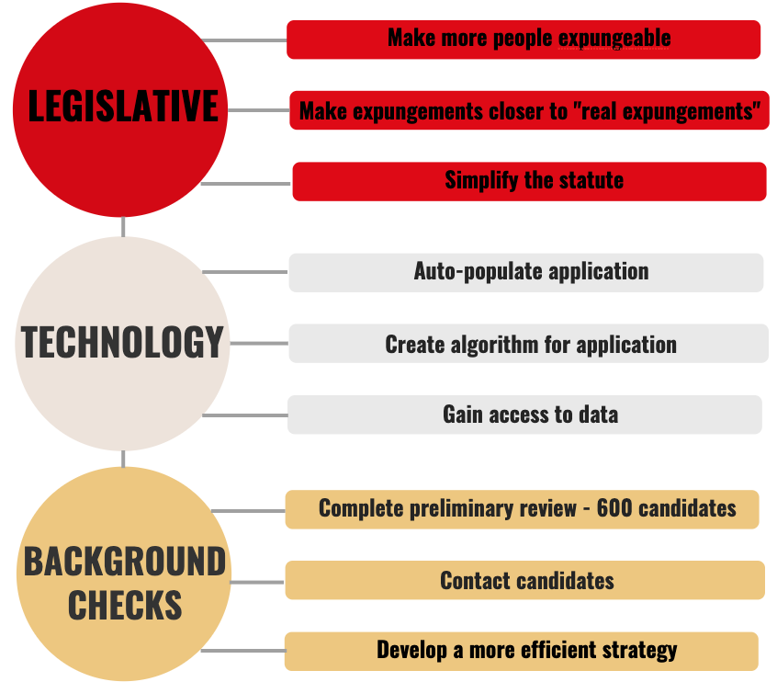
OUR
2020 GOALS
Notes:
Ellen - OK

Slide 25
Questions?
Notes:
Ellen - OK as lead

